Slide 1
Travelling Salesman problem
108753208 葉冠宏

Slide 2
Problem definition
1. Salesman starts from one city
2.Go to all other city just once
3.And come back to the original city
Goal: finding the least cost(distance) path with above conditions

Slide 3
approximation algorithm-Christofides algorithm(3/2 )
Step1: Find a minimum spanning tree T
Step2: Let O be the set of vertices with odd degree in T. Find a minimum-cost perfect matching M
Step3:Add the set of edges of M to T. Find a Eulerian tour.
Step4:Shortcut the Eulerian tour to make a Hamiltonian Cycle.

Slide 4
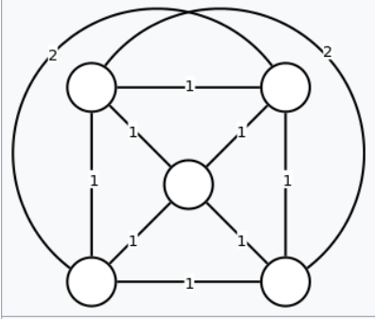
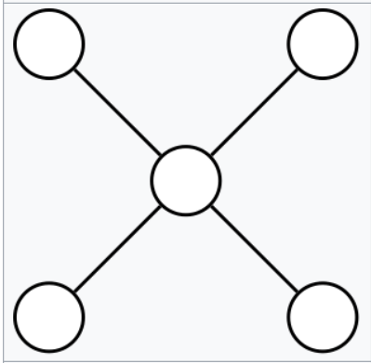
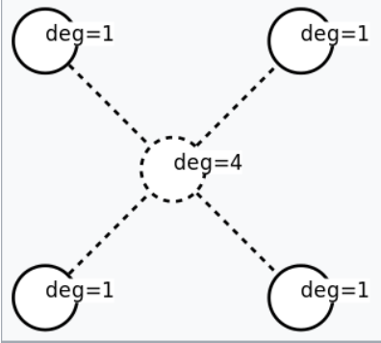
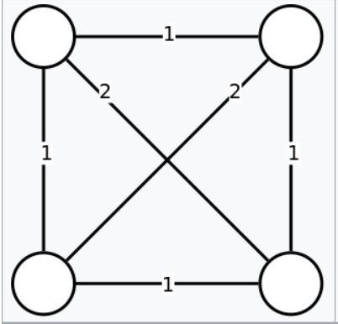
Example
Given: complete graph whose edge weights obey the triangle inequality
Calculate minimum spanning tree T
Calculate the set of vertices O with odd degree in T
Form the subgraph of G using only the vertices of O

Slide 5
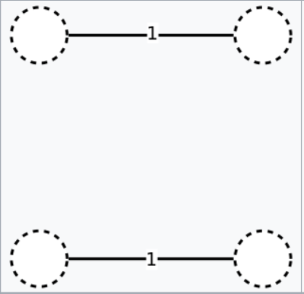
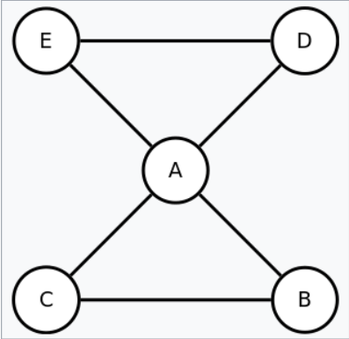
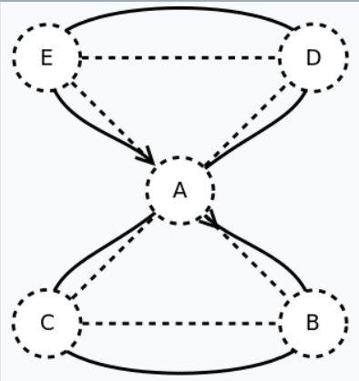
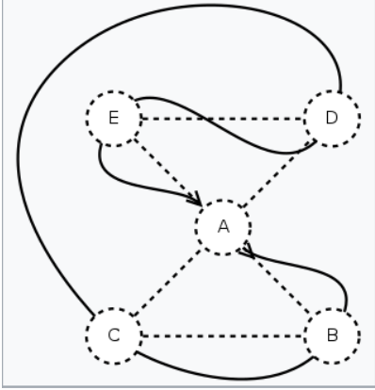
Construct a minimum-weight perfect matching M in this subgraph
Unite matching and spanning tree T ∪ M to form an Eulerian multigraph
Calculate Euler tour
Remove repeated vertices, giving the algorithm's output

Slide 6
Comparison1-brute force
1.Generate all (n-1)! Permutations of cities.
2.Calculate the cost of every permutation and keep track of the minimum cost permutation.
3.Return the permutation with minimum cost.

Slide 7
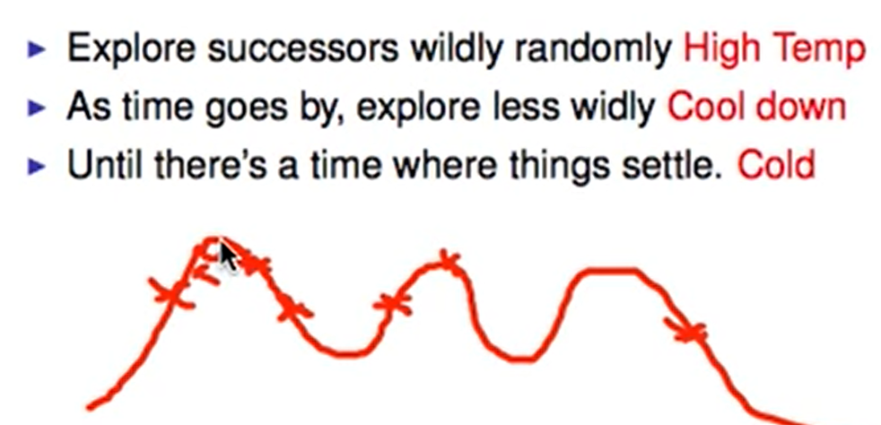
Comparison2-Simulated Annealing

Slide 8


Slide 9
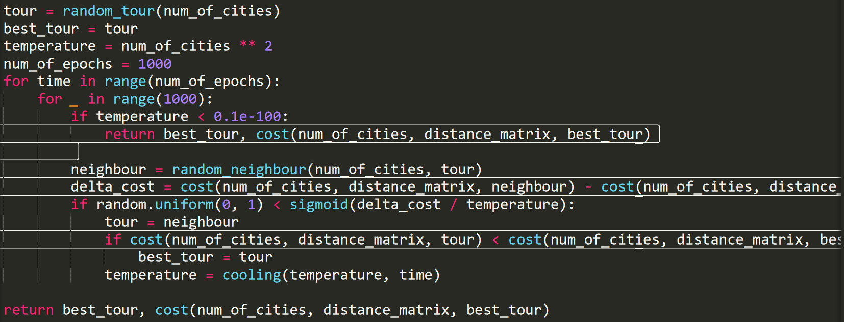
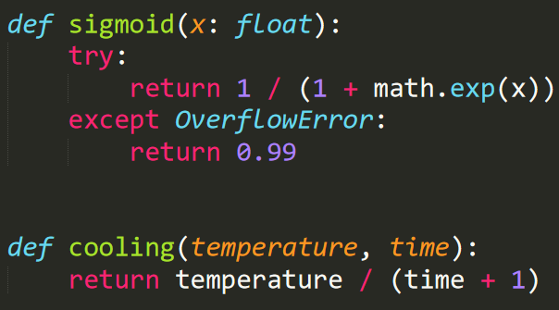

Slide 10
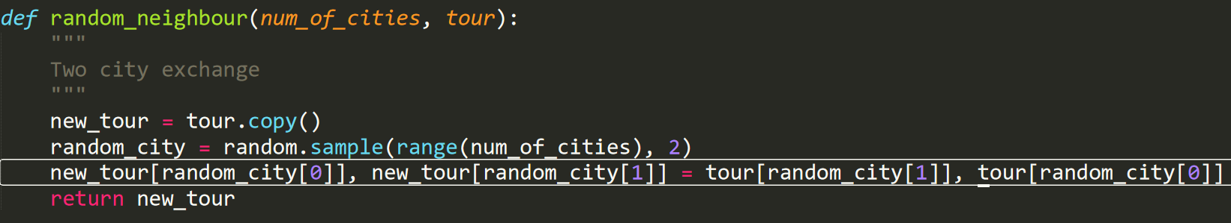

Slide 11
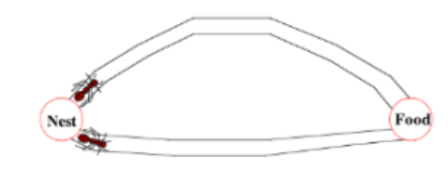
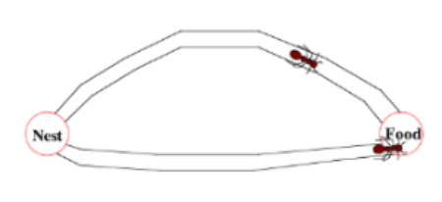
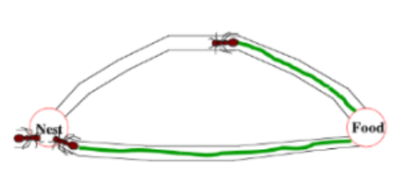
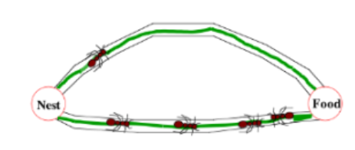
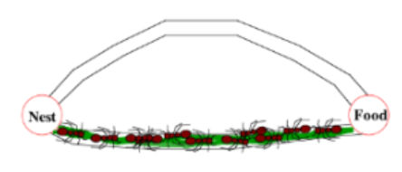
Comparison3-Ant Colony Optimization Algorithm

Slide 12
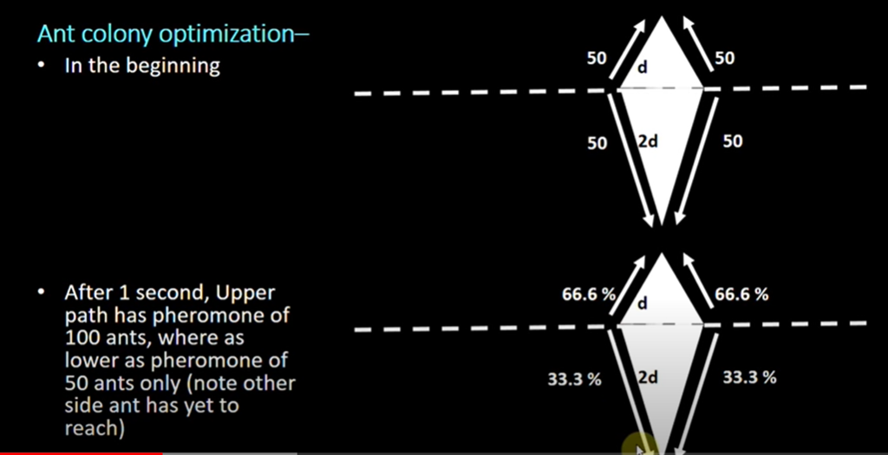

Slide 13
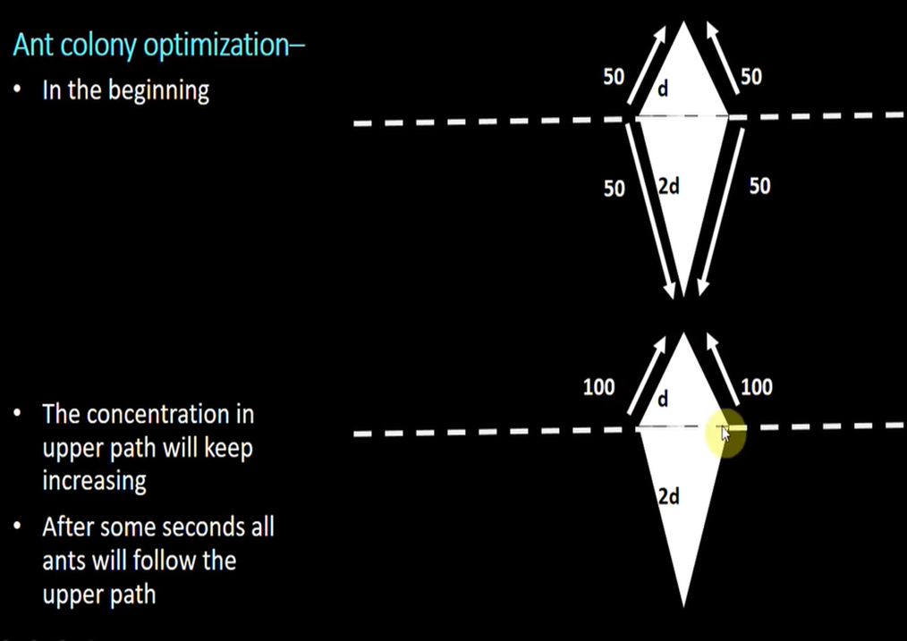

Slide 14
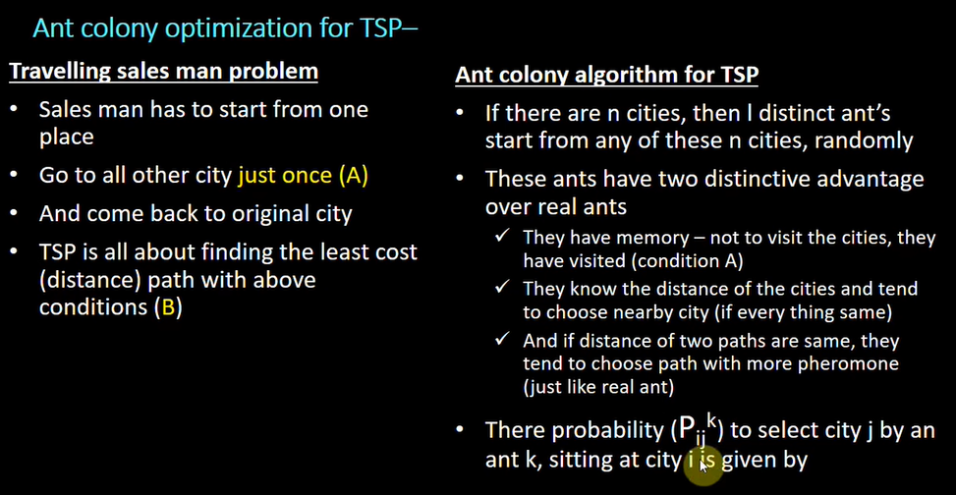

Slide 15
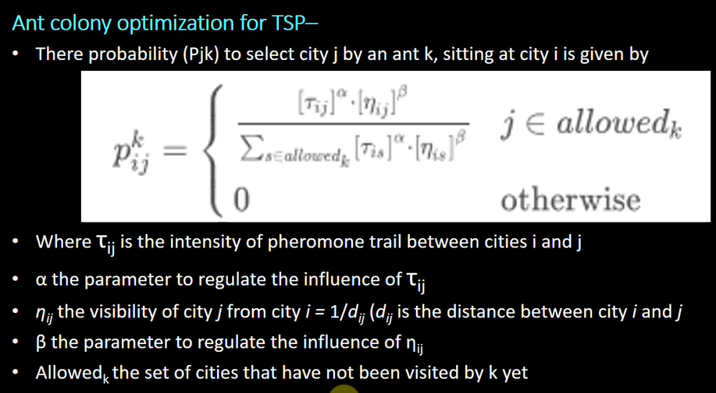

Slide 16
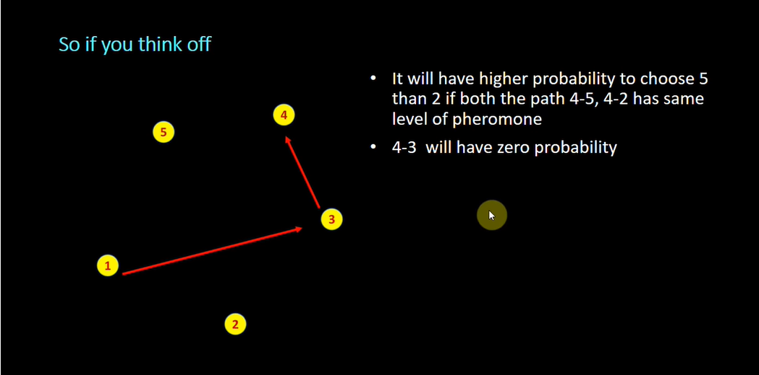

Slide 17
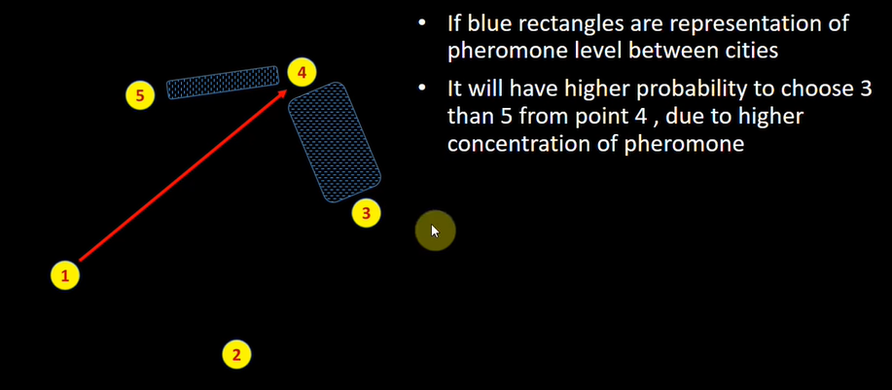

Slide 18
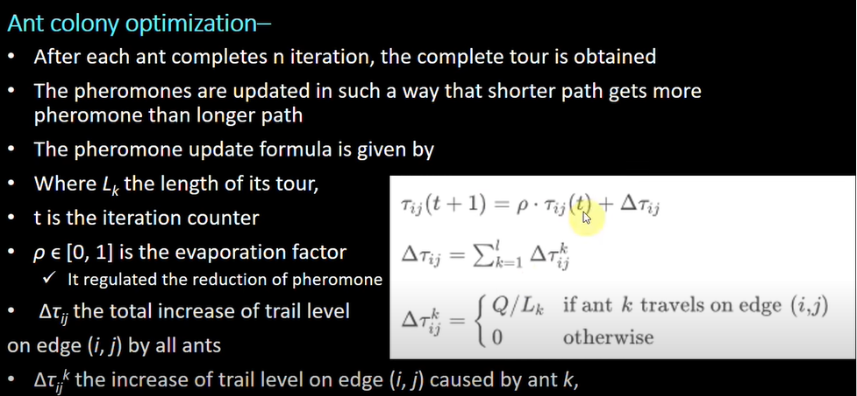

Slide 19
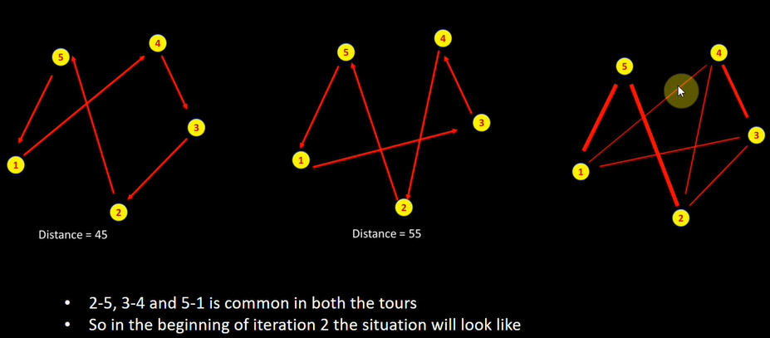

Slide 20
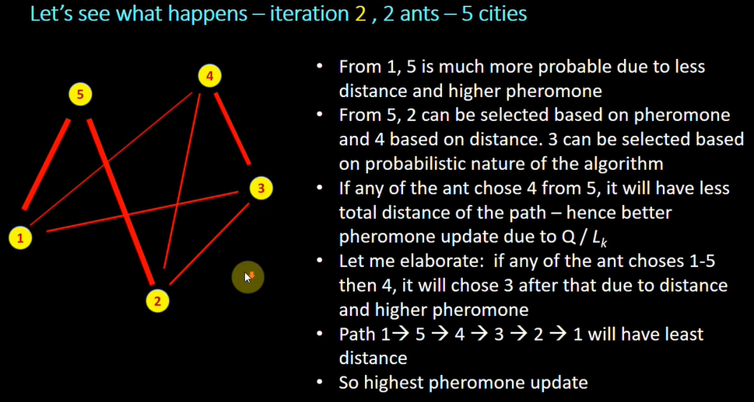

Slide 21
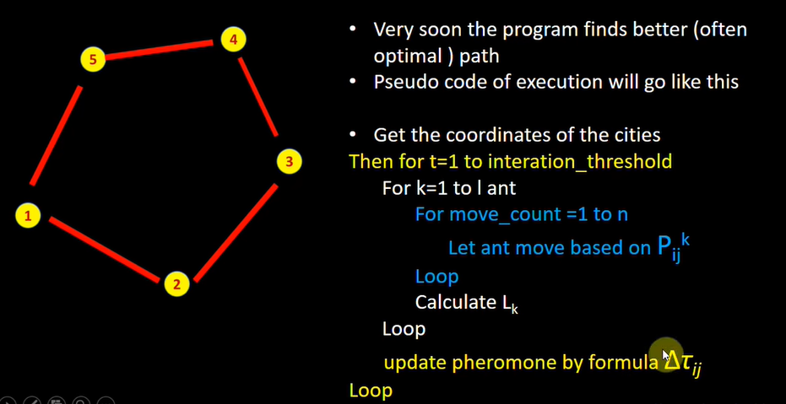

Slide 22
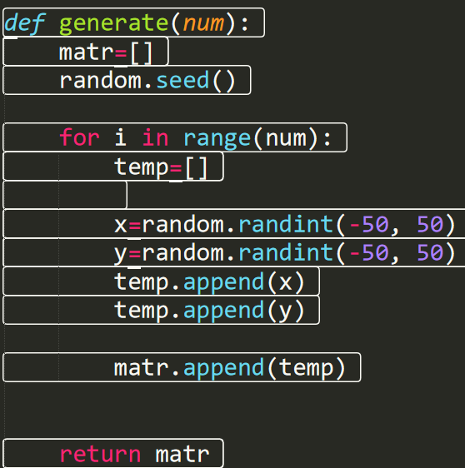
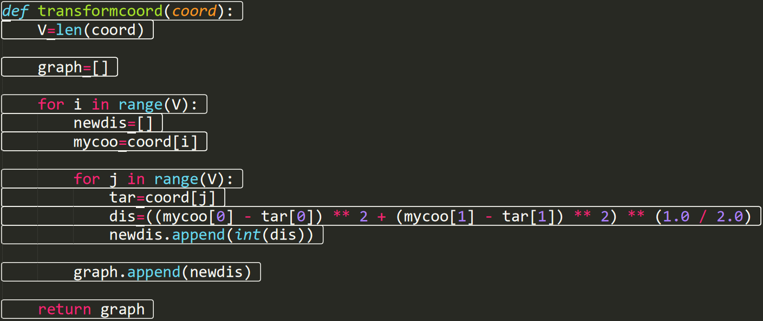
input產生

Slide 23
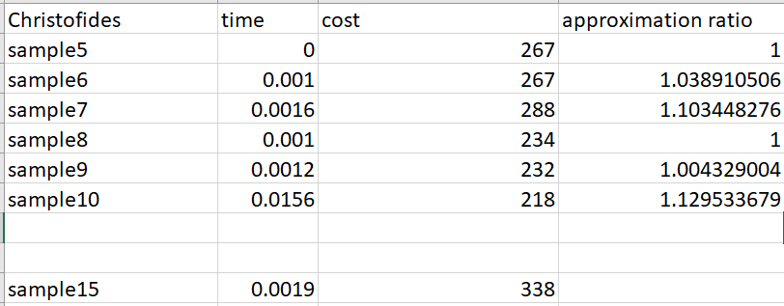
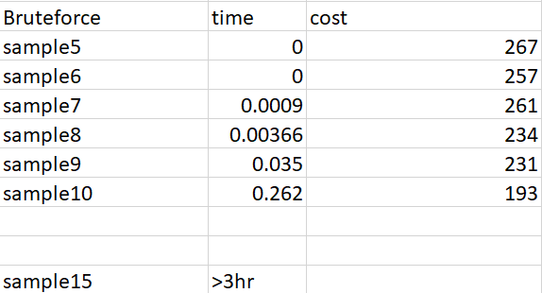
實驗-Christofides, Brute force
Brute force在city小於10時很快，但在超過10時就變得很慢了
1.Approximation ratio 在city<10時都維持在1.1以下
2.每次跑的cost, path結果都一樣
3.所花費時間不多
4.可以跑至多city時

Slide 24
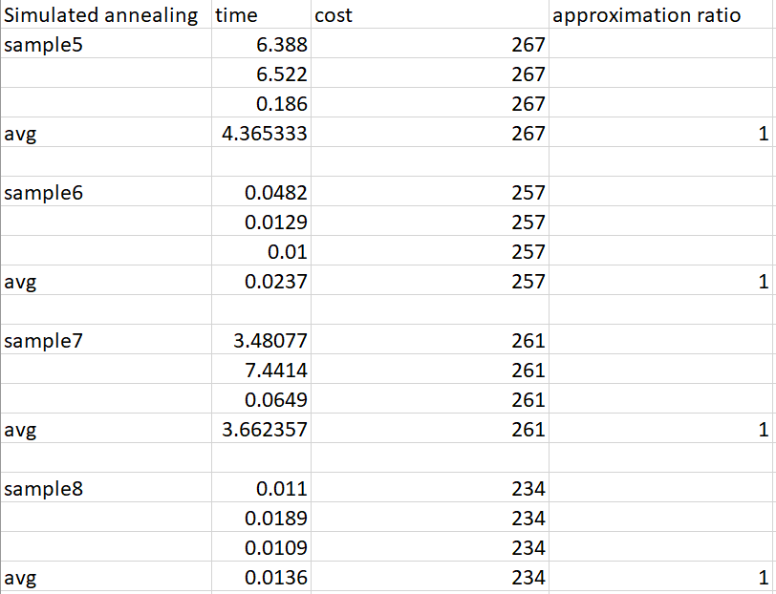
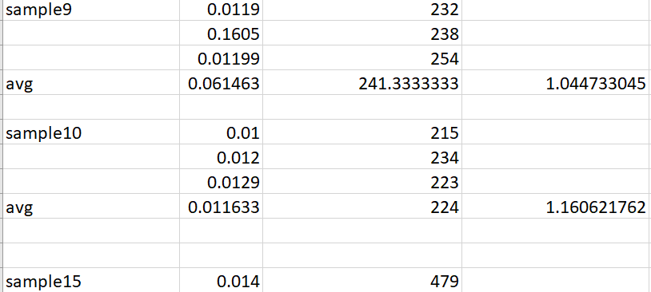
實驗-Simulated annealing
Simulated annealing cost及path的結果在city<9時不管跑幾次都一樣,但隨著city>=9之後每次跑的結果會略為波動。
有時候花的時間略長，但approximation ratio 都蠻好的，在1.1左右，而其會隨樣本數越多而上升。

Slide 25
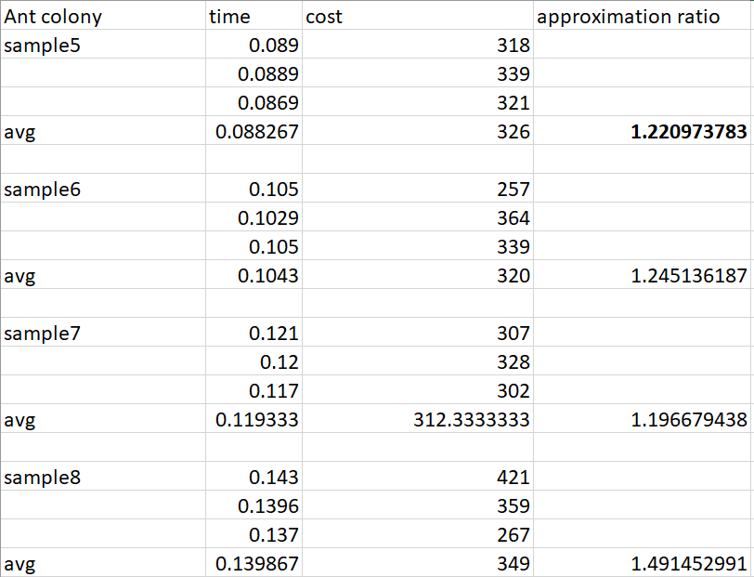
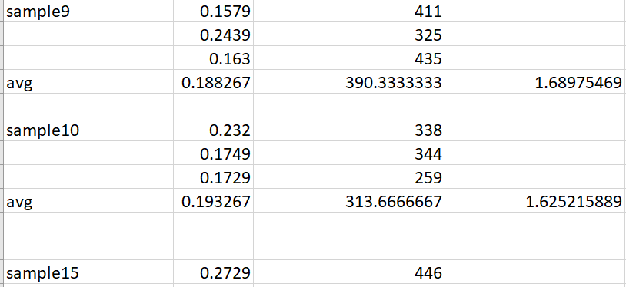
實驗-Ant Colony Optimization
Ant Colony Optimization 所呈現的平均 approximation ratio 都偏高，即使在很低樣本的時候，大約在1.5左右。
而且每次跑的實驗結果都不一樣。

Slide 26
Reference
https://www.youtube.com/watch?v=C86j1AoMRr0
https://en.wikipedia.org/wiki/Simulated_annealing
https://www.geeksforgeeks.org/traveling-salesman-problem-tsp-implementation/
https://github.com/Retsediv/ChristofidesAlgorithm/blob/master/christofides.py

